Slide 1




Gradient-Domain
Photon Density Estimation
Binh-Son Hua¹ Adrien Gruson² Derek Nowrouzezahrai³ Toshiya Hachisuka²
¹Singapore University of Technology and Design ²The University of Tokyo ³McGill University
Notes:
Thanks you everyone to coming to see my talk.
I’m Adrien Gruson and today I will talk about Gradient-Domain photon density estimation.

Slide 2
Classical rendering
Notes:
But first, before talking about gradient-domain rendering, I will briefly talk about non-gradient rendering.

Slide 3
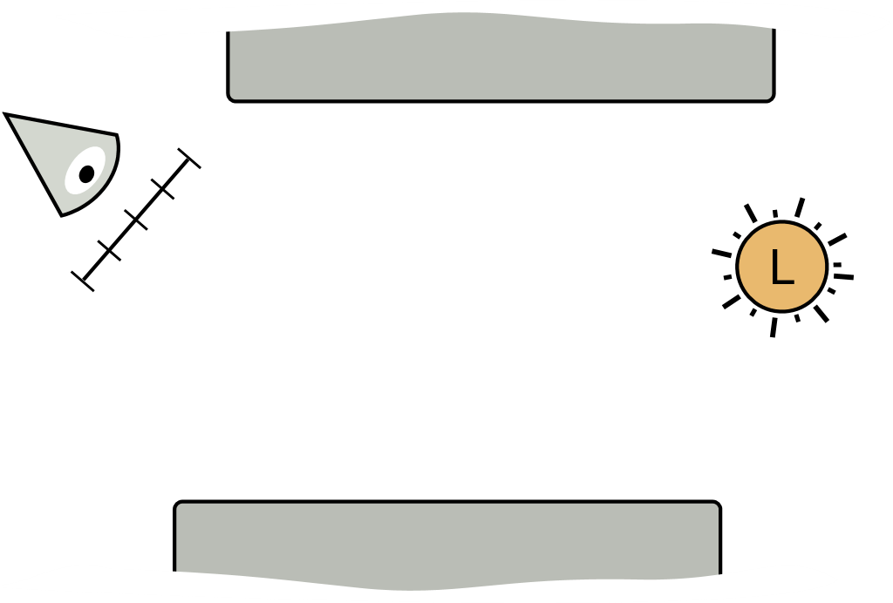
Classical rendering
Path-based rendering techniques
(i.e Path tracing …)
Density-based rendering techniques (i.e SPPM [Hachisuka et al. 2008]…)
Notes:
In the classical rendering, there is two main type of technique.
The first one are path-based rendering approach that construct the path incrementally from the sensor or the light by bouncing over the surfaces.
The second type of rendering technique is density-based rendering techniques which have two step.
First step, several light path are generated from the light source and all their vertices are stored inside a spatial data structure.
Second step, a path is generated from the sensor and at some point there is a density estimation. The density estimation gather all neighboring light path and merge them to create full light path that connect the sensor to the light.

Slide 4
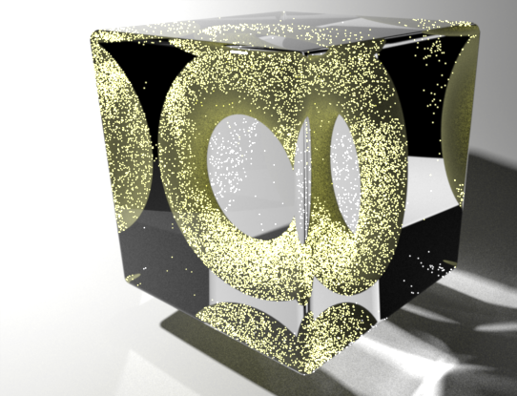
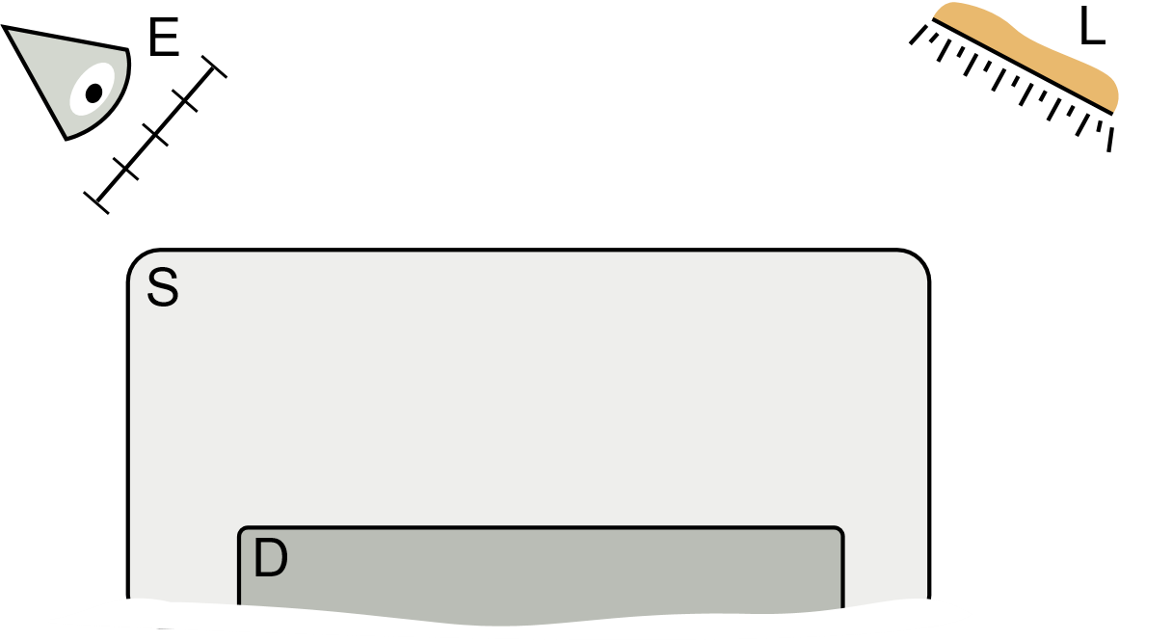
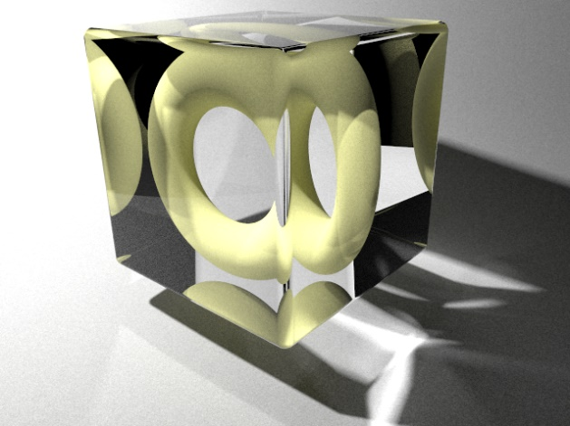

Classical rendering
Path-based techniques are not robust to SDS Light Tranport
Path-based
Density-based
S
D
Notes:
However, it is known that path-based rendering approach have some problem with “specular diffuse specular” light transport.
This difficulty is due to the fact that specular material like mirror, restrict the bouncing direction. It have some consequence that path-based approach are not good to handle this constraint and have a lot of noise in this light transport
As it is shown in this image where there is a lot of noise on the yellow donuts.
In comparison, Density-based technique are more robust to this light transport and produce image with lower level of noise.

Slide 5
Gradient-domain rendering
Notes:
Now, let’s jump into gradient-domain rendering.

Slide 6
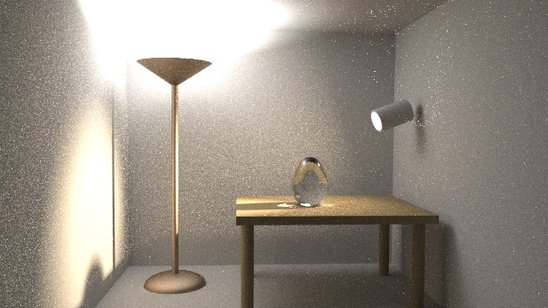
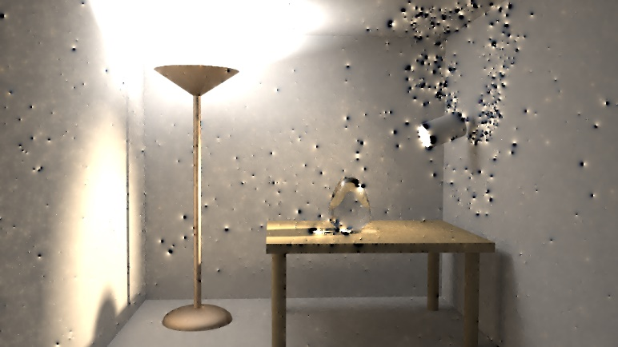
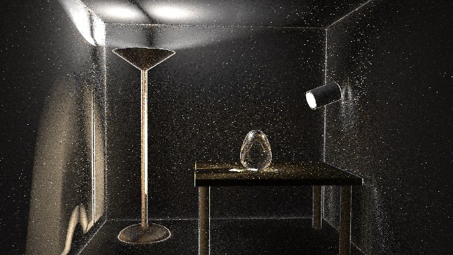
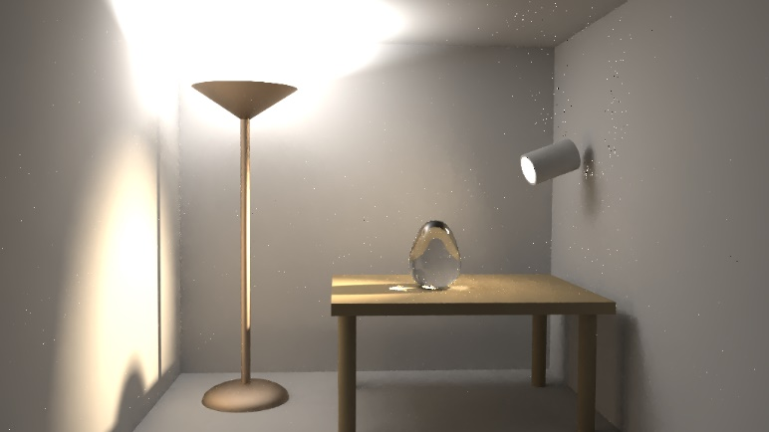
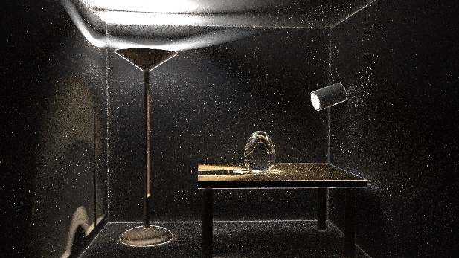
Gradient-domain rendering
Classical rendering + image-based gradients
Primal-domain
(i.e Path tracing)
L2
Poisson
reconstruction
Horizontal
L1
Gradients
Vertical
Notes:
In gradient-domain, we still estimate an image exactly in the same way as classical rendering (but we call it “PRIMAL-DOMAIN IMAGE”.
HOWEVER, during the rendering process, we also estimate image-based gradients (vertical and horizontal one).
We use these 3 informations to do a poisson reconstruction process.
Depending of the norm used in the poisson reconstruction we can have:
unbiased results with L2 norm but where it is possible to have some dipole artefact.
Or more robust but biased results with L1 norm where we can have a loss of energy.
One of thing important with gradient-domain rendering, is how the gradient are computed. SO I will detail more this part.

Slide 7
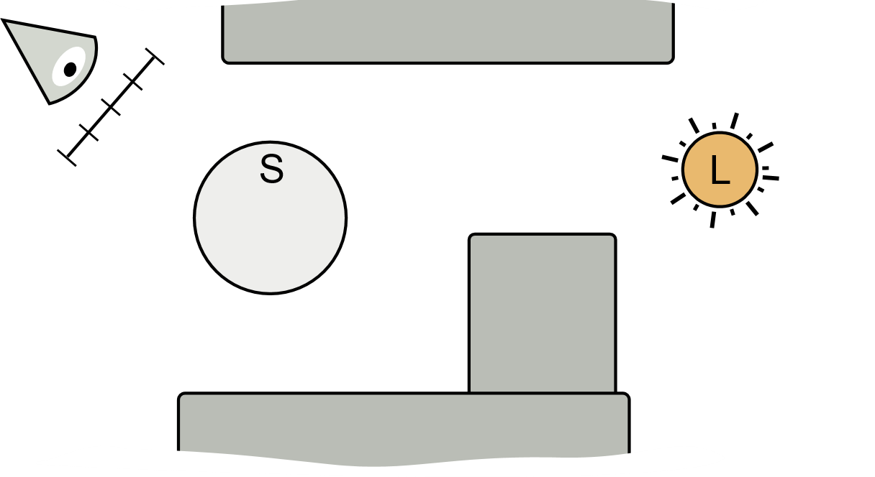
Gradient-domain rendering
Shift mapping: exploit coherency to reduce noise in gradients.
1) Generate the base path
D
D
Notes:
To compute the image-based gradients, previous authors propose to use a shift mapping. The key idea to get low variance in the gradient is to exploit coherency.
In practice it works at the following.
First, we generate a base path as the same way that we do for classical rendering.

Slide 8
Gradient-domain rendering
Shift mapping: exploit coherency to reduce noise in gradients.
2) Generate shift paths through neighbor pixel
D
D
Notes:
Second, we generate a shift path that passing through neighbor pixel. However, as I said before we want to make the path coherent as much as we can. So we might want to reconnect the shift path to the base path as soon as possible.
However, due the specular material here, we cannot reconnect here. So we need to extend the shift path until we reach a enough diffuse surface to make this reconnection possible.

Slide 9
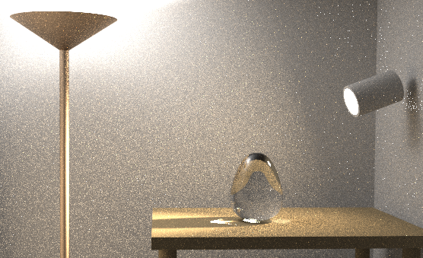

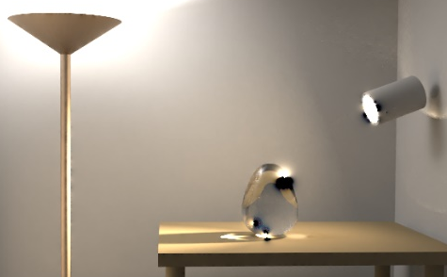
Gradient-domain rendering – Related works
Gradient-domain Metropolis light transport [Lehtinen et al. 2013]:
(+) Adaptive density (-) Markov chain MC
Gradient-domain path tracing, [Kettunen et al. 2015]
(+) Simple (-) No adaptive sampling
Gradient-domain bi-directional path tracing [Manzi et al. 2015]
(+) More robust (-) More costly
PT
G-PT L2
G-BDPT L2
Notes:
IN TERM OF RELATED WORK, the first work was “Gradient-domain metropolis light transport” where the authors used a MARKOV CHAIN MONTE CARLO to adaptively put more sample on region with high gradient value. HOWEVER, this technique share the limitation of MARKOV CHAIN MONTE CARLO where the convergence is not uniform over the image plane.
A more recent work is “Gradient-domain path tracing”. Here, no adaptive sampling or Markov chain monte carlo. Here, the authors use a simpler approach based on a regular path tracing and use a similar shift mapping that I have described before. Compare to regular path tracing, the authors get a good speed-up.
In comparison to the path tracing image show here, Gradient-domain path tracing remove a bit part of the noise. However, there is still a lot of dipole artefact due to the poor performance of path tracing to sample this type of light transport.
Finally, the newest method “Gradient-domain bidirectional path tracing” where it is build on bidirectional path tracing show better robustness compare to the gradient-domain path tracing.

Slide 10
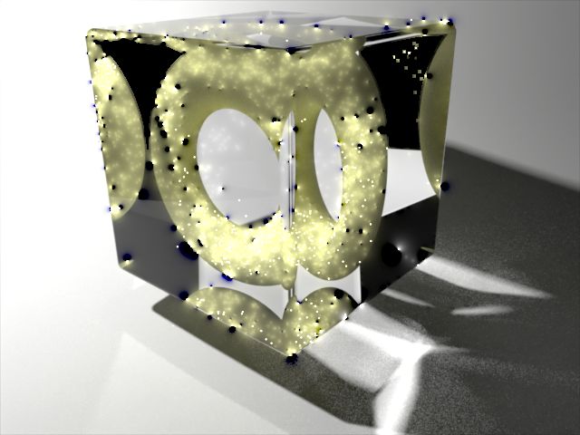
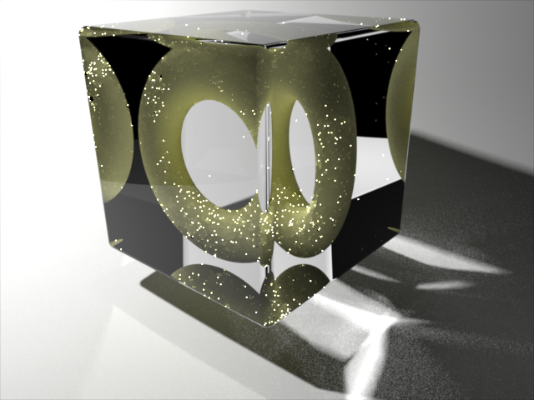
Problem
Current gradient-domain rendering is path-based
= Problems with SDS paths
Our goal: Is to use photon density estimation as the primal technique and compute gradient information.
?
G-BDPT L2
G-BDPT L1
SPPM
G-SPPM
Notes:
HOWEVER, The current problem is that all gradient-domain rendering is path-based approach and have still some issue on the Specular Diffuse Specular light transport.
In this case, Gradient-domain rendering doesn’t really help here as: L2 have a lot of dipole artefact and L1 have a huge loss of energy.
In comparison, photon density estimation is ROBUST to such light transport but noise is visible due to the photon sampling process.
Our goal is our technique is to IMPROVE THE ROBUSTNESS of gradient-domain techniques using photon density estimation as the primal technique.

Slide 11
Hybrid shift mapping
Photon density estimation:
Two independent paths that compose the base path
How to define a proper shift operator?
Notes:
However, one of the main difficulties is compare to previous works, we have two independent path that are merged using density estimation.
So we need to ensure when we will shift this pair of path to make the shift sensor and camera path lying close to each other to be compatible with density estimation.
So the question that we address in this talk is “how to define a proper shift operator?” for this type of rendering technique.

Slide 12
Gradient-domain Photon Density Estimation
Notes:
(~8 min)
Now, let’s give some more details about our technique named “Gradient-domain photon density estimation”.

Slide 13
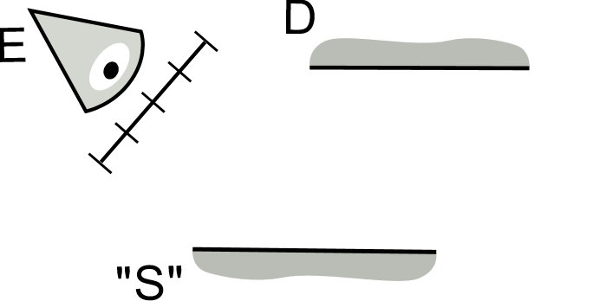





Step 1: Shift sensor path
$$z_{i+1}^{′}$$
$$z_{i+1}$$
Half vector copy [Manzi et al. 2015]
Copy
$$z_{i}^{′}$$
$$z_{i}$$
Half vector
Notes:
The first step of our shift mapping is to shift the sensor path.
One important information is that when we generate the base sensor path if we encounter not enough smooth surface, we bounce over it until reach a diffuse surface.
Each time we bounce over a surface, we can define an half vector which have the same angle between the incoming and outgoing direction.
Then when we generate the shift sensor path, we also need to bounce over not enough smooth surface. To determine the outgoing direction we copy the half vector from the base path. This scheme is simple and try to create coherent sensor shift path.
Note that this technique have been used in gradient-path tracing as well.
After this first step, we have shifted the sensor path entirely, now we need to go to the next step.

Slide 14
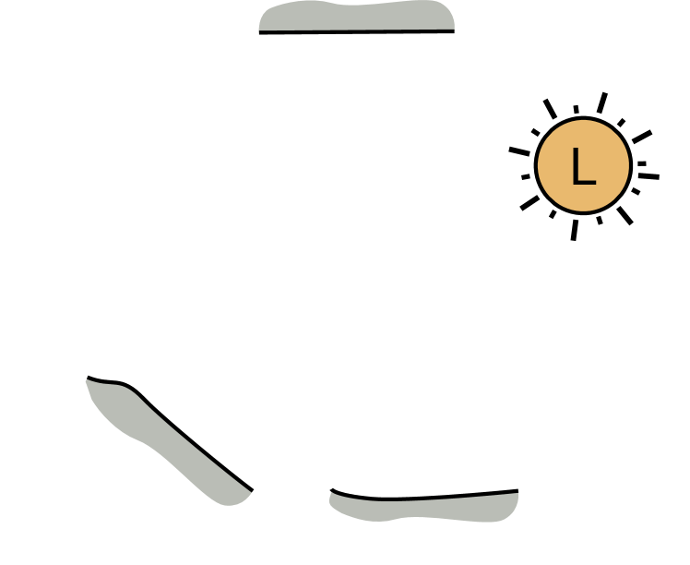






Step 2: Shift photon location
$$y_{s−1}$$
Copy
$$y_{s}$$
$$z_{t}$$
$$y_{s}^{′}$$
$$z_{t}^{′}$$
Notes:
During the second step, we want to ensure the shift photon will lying inside the shift sensor path kernel.
To ensure that we first look at the parametrization of the current photon of the base sensor path.
Then, we copy this parametrization and applied back to the shift sensor path to determine the shift photon location.
However, as this procedure cannot ensure that the shift photon location is lying on a surface, we trace a ray from the parent photon to project it.

Slide 15
Step 3: Shift the rest of the light path
Notes:
After we determine the shift photon location, we can try to reuse the light path as much as we can by reconnect the shift photon to the parent photon.
However, in this case, we have specular material that make impossible this connection.
So we need to do a THRID AND LAST step that is “Shift the rest of the light path”.

Slide 16
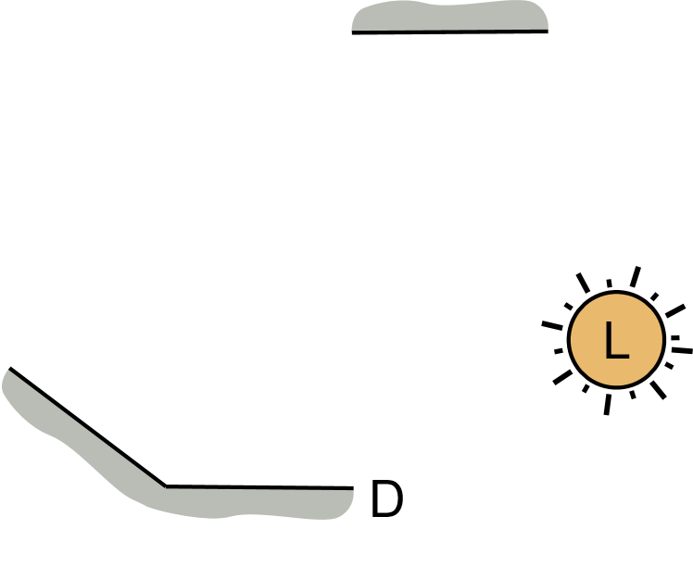
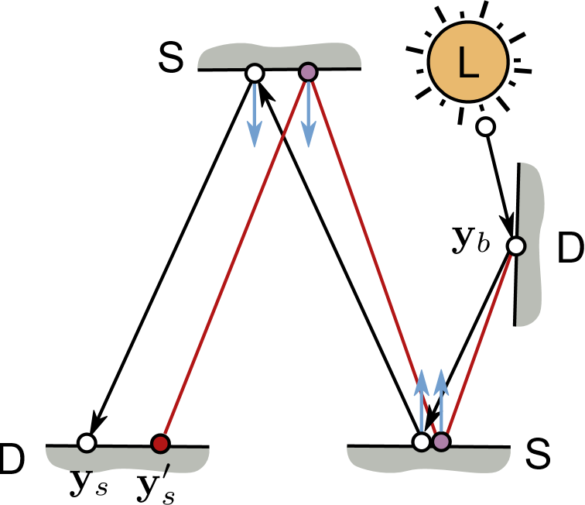






Step 3: Shift the rest of the light path
Case 1: Diffuse parent
Case 2: “Specular” parent
$$y_{s−1}$$
$$x_{t}$$
$$y_{s}^{′}$$
$$y_{s}$$
$$x_{t}^{′}$$
$$y_{s}^{∗}$$
Find a valid light path
using Manifold Exploration
[Jakob et al. 2012].
Notes:
In this step, we have 2 cases.
The first case is when the parent photon is lying on a diffuse or mostly diffuse surface. In case, we didn’t need to do any thing and can directly do a reconnection.
The second case is when the parent photon is on a specular or nearly specular surface. In this case, we have to construct a path between the shift photon location and the first diffuse parent, here “why” b. These two point are our constrain and we use Manifold exploration to order to found the missing path. Note that this approach have been also use in Gradient-domain bidirectional path tracing.

Slide 17
Finish !
Notes:
After these 3 steps, we have generated a pair of shift path and can use it to compute the image-based gradients.

Slide 18
Jacobian: See the paper !
Notes:
One thing I didn’t mention during the presentation is the Jacobian. The Jacobian is the mathematical formulation of the change of measure due to the shift mapping.
Having a correct Jacobian is important to get correct gradient values.
Please look at the paper for more details!

Slide 19
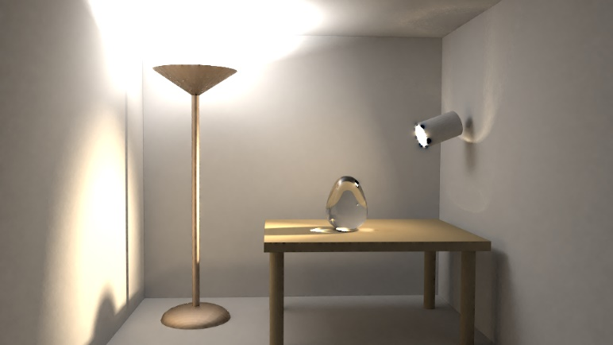

Gradient-domain density estimation
Consistent: Use same reduction scheme as SPPM
Primal-domain
SPPM
L2
Poisson
reconstruction
Our shift
mapping
L1
Gradients
Notes:
So now, if I summarize, we have as the primal-domain technique stochastic progressive photon mapping.
For computing the gradient, we use our new shift mapping.
In order to get a consistent estimator we use the same reduction rate as SPPM.
We use the same poisson reconstruction as previous gradient-domain works and at the end, we can get an L2 or L1 reconstruction image.
Note that, these two norm produce similar results except in few cases as density estimation technique is more robust.

Slide 20
Results
Equal-time comparison between
G-BDPT L1 [Manzi et al. 2015]
Stochastic progressive photon mapping [Hachisuka et al. 2008]
Our technique L2
Metric: Relative MSE
More comparison (G-PT, BDPT, …) on the additional material
Notes:
Concerning the results, I will show you equal time comparison here.
We will compare with:
Gradient-domain bidirectional path tracing with L1 reconstruction. We choose to show L1 reconstruction as L2 reconstruction generate a lot of dipole artefact.
Regular SPPM without gradient computation and no Poisson reconstruction
Our technique with L2 reconstruction as our technique doesn’t required L1 reconstruction (only in some cases)
The metric that we will use is Relative MSE and if you want to see more comparison, like G-PT or BDPT, please have a look to the additional material.

Slide 21
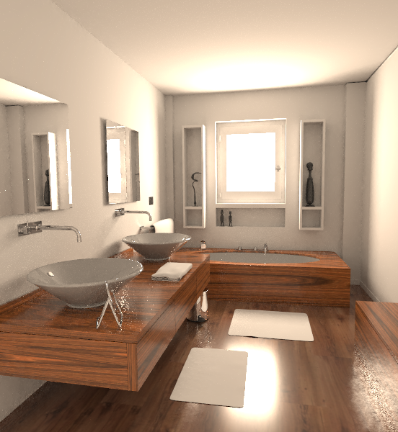

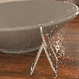

G-BDPT L1 – 5 min
G-BDPT L1
21
Notes:
It is the bathroom scene with 5 min of rendering. We can see G-BDPT produce a almost clean results for almost all the image. Like here the diffuse wall which have a lot of Diffuse light transport.
However, for complex light transport, like the specular trash bin with the glossy floor or the caustic, G-BDPT have a lot of noise. It is mostly due to the fact that BDPT cannot really handle efficiently these paths.

Slide 22
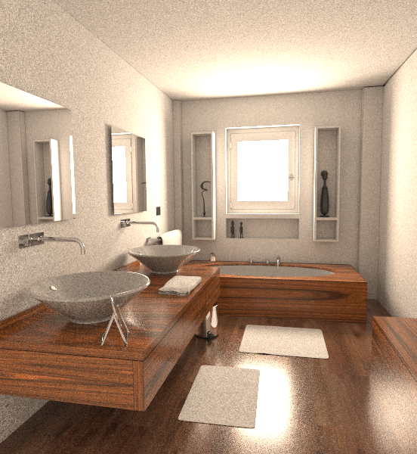

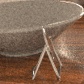

SPPM – 5 min
G-BDPT L1
SPPM
Notes:
In comparison, SPPM produce more noise in all the image part. This is especially true for the diffuse/diffuse light transport where the photon are incoherent and produce a lot of noise.
However, in the complex light transport, this technique doesn’t have any “spike” problem compared to G-BDPT with L1 reconstruction.

Slide 23
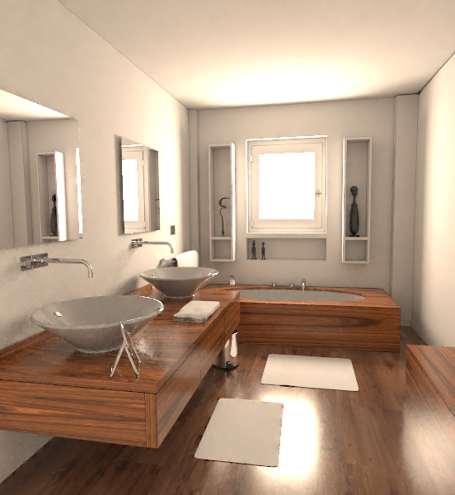

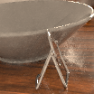

Ours L2 – 5 min
G-BDPT L1
SPPM
Ours L2
Notes:
In our approach, as we do the poisson reconstruction, we filter most of the noise. It is especially visible for diffuse/diffuse light transport where we get similar results compare to G-BDPT.
However, compare to G-BDPT, our technique doesn’t suffer about the spike in complex light. We get also better results compare to SPPM as the compute coherent gradient that helps to reconstruct the image.

Slide 24


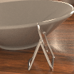

Reference
G-BDPT L1
SPPM
Ours L2
Ref.
Notes:
[Said that compare to Reference, our technique generate quite close results but only for 5 min of rendering.]

Slide 25
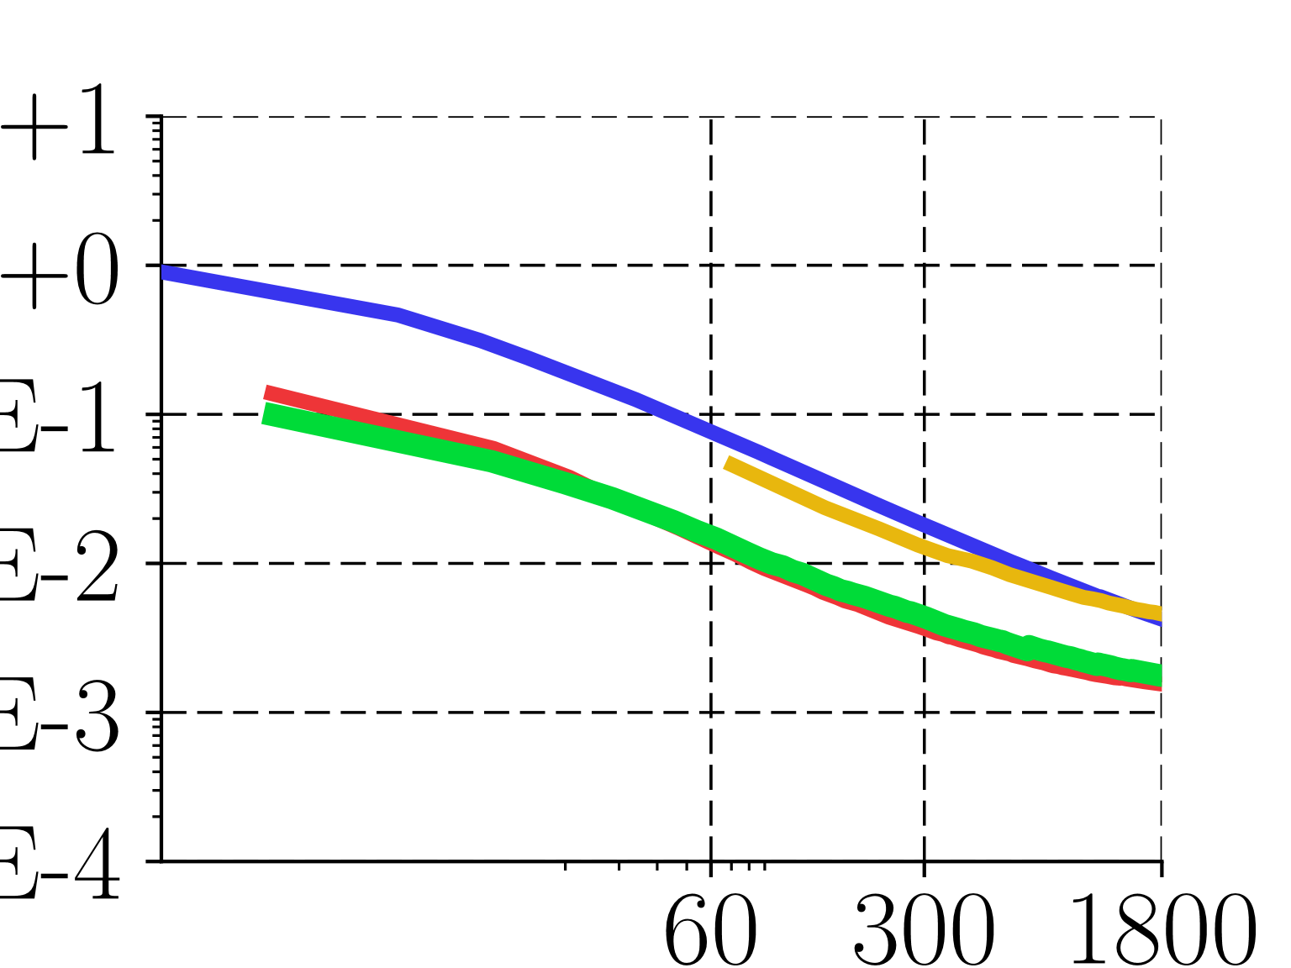
relMSE
Time
G-BDPT L1
SPPM
Ours L1
Ours L2
Notes:
In term of metric, SPPM and G-BDPT have the same value.
It is due to the fact that SPPM is better for complex light transport but G-BDPT have a better handling of diffuse/diffuse light transport.
In our technique, as the robustly handle all the light transport and compute coherent gradient, we get a huge quality improvement due to the poisson reconsutrction.

Slide 26



G-BDPT L1
G-BDPT L1 – 5 min
Notes:
In this scene, there is a lot of SDS path.
In this case, we expect that G-BDPT failed completely. However, for simple refraction or direct lighting. G-BDPT produce clean images.

Slide 27
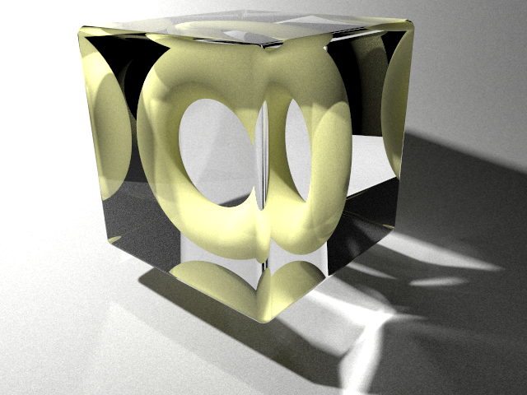



G-BDPT L1
SPPM – 5 min
SPPM
Notes:
In comparison, as the scene have a lot of SDS path, SPPM handle them quite correctly, leading more noise globaly but without producing spikes.

Slide 28




G-BDPT L1
Ours L2 – 5 min
SPPM
Ours L2
Notes:
Our methods make possible to remove all the noise in the SDS path and direct path (or simpler caustics). However, for the difficult caustic, the noise is higher as here the light path are complicated and Manifold exploration failed to generate the correct shift light path. In this situation, the noise inside the gradient impact the reconstruction in a negative way and doesn’t show any improvement for this region.
As our method have a overhead (computation of the gradient), the results will worst compare to classical SPPM.

Slide 29




G-BDPT L1
Reference
SPPM
Ours L2
Ref.

Slide 30
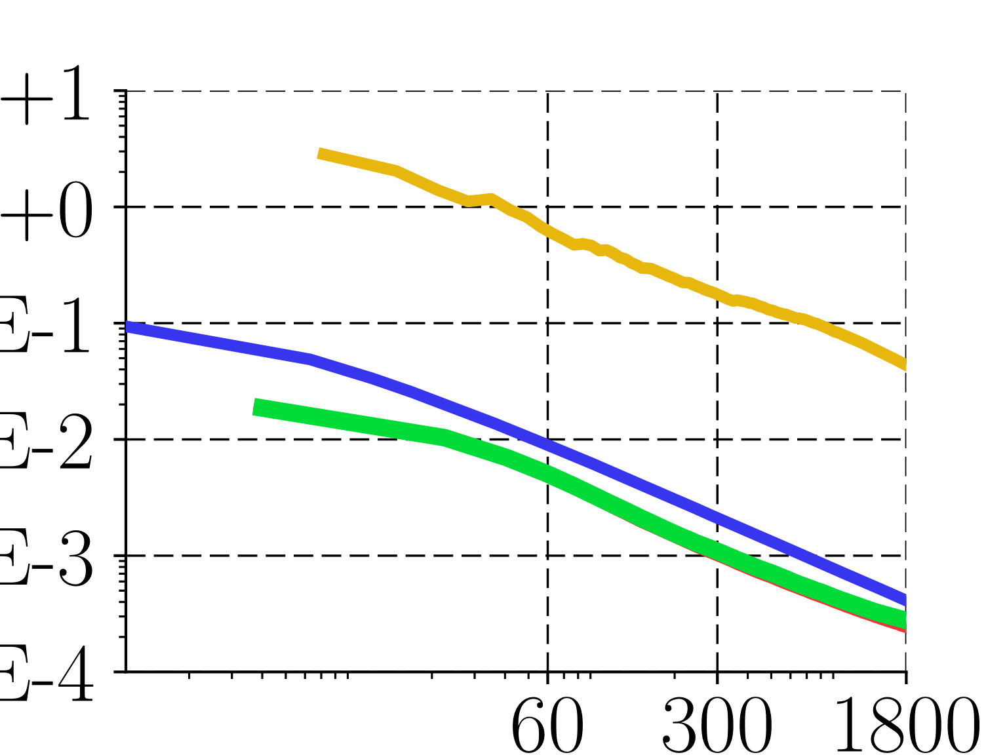
relMSE
Time
G-BDPT L1
SPPM
Ours L1
Ours L2
Notes:
In term of metric, as the problem of Manifold exploration doesn’t occurs often, we have a gain compare to SPPM.

Slide 31
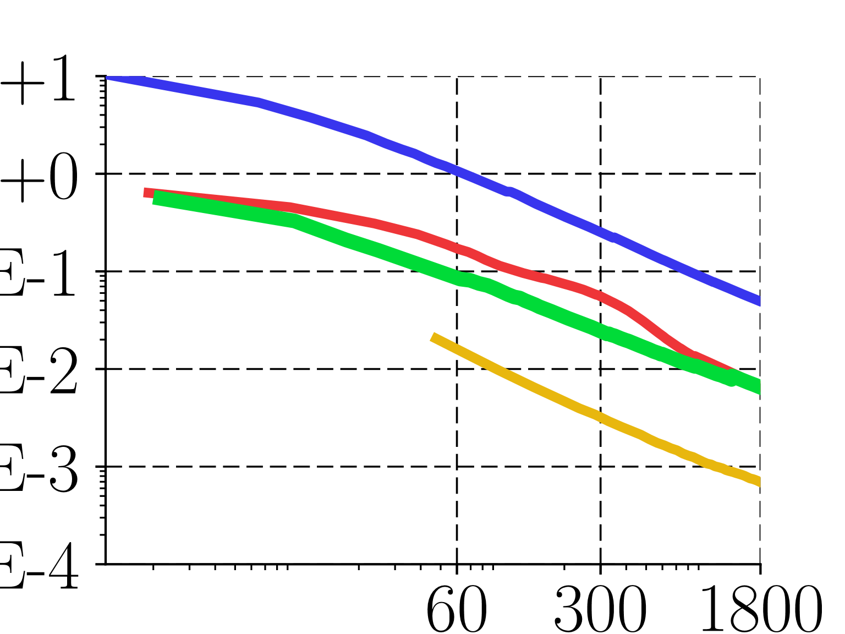
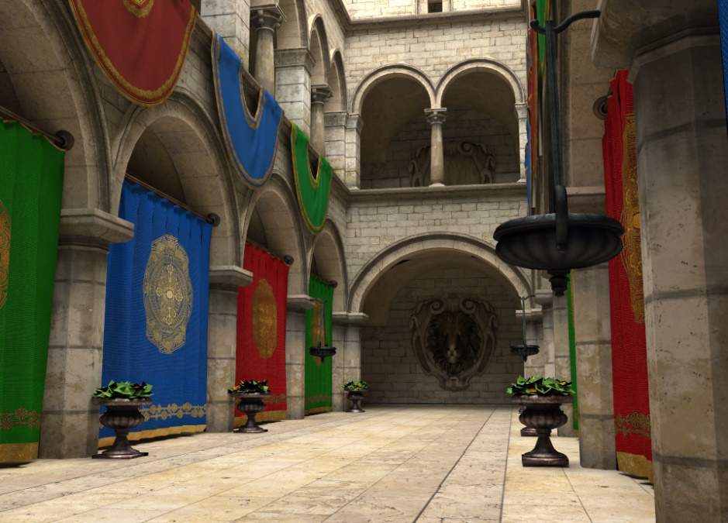
Sponza
relMSE
Time
G-BDPT L1
SPPM
Ours L1
Ours L2
Notes:
This scene is a diffuse scene where there is not specular material. In this scene, G-BDPT doesn’t have any issue to handle diffuse/diffuse light transport and generate a good image rapidely.
In this scene, as SPPM doesn’t ensure stratification, the noise is high as the distribution of photon is not uniform. However, our technique makes possible to filter the noise and give a good speedup in term of relative MSE. However, G-BDPT do a better job here as it have a better stratification and sampling strategy.

Slide 32

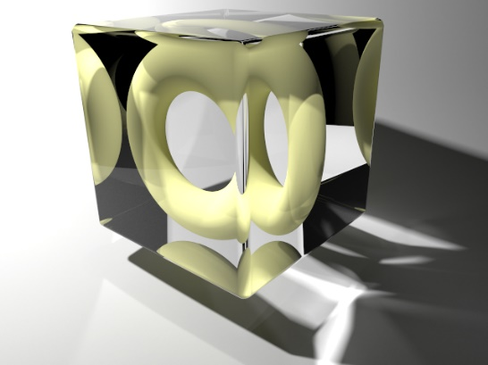
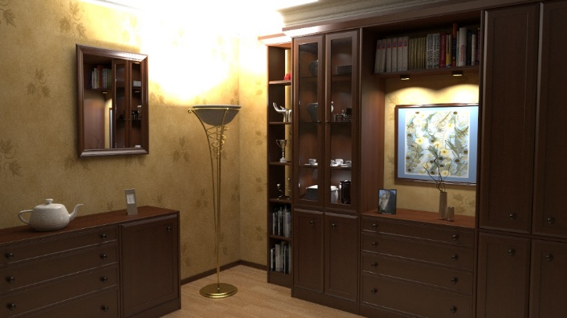


Number of iterations
Notes:
Overhead between 1.3 to 3.3
The variation of the overhead is due to the percentage of use of Manifold exploration (Torus scene)

Slide 33
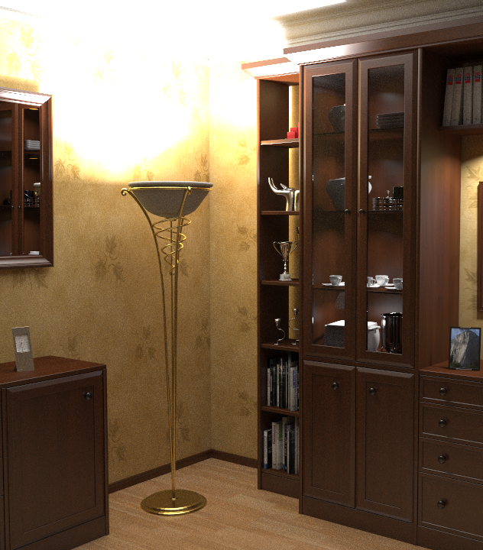






Limitations
1) Gather photon on glossy surfaces
SPPM
Possible solution:
G-VCM/UPS [Georgiev et al. 2013, Hachisuka et al. 2013]
Ours
G-BDPT

Slide 34
Limitations
2) Non uniform photon distribution
Possible solution:
MCMC [Hachisuka et al. 2011, Gruson et al. 2016]

Slide 35
Conclusion
First gradient-domain photon density estimation technique.
  New Hybrid shift mapping
Take home message:
  Good throughput + coherent gradients --> convergence boost.
  The robustness of the primal path sampling method is important.

Slide 36
Gradient-Domain
Photon Density Estimation
https://github.com/gradientpm/gpm
Thank you for your attention!
Binh-Son Hua¹ Adrien Gruson² Derek Nowrouzezahrai³ Toshiya Hachisuka²
¹Singapore University of Technology and Design ²The University of Tokyo ³McGill University
Notes:
The code of our technique is available on github. Please check it out.
Thanks you for your attention.

Slide 38
Backup slides

Slide 39
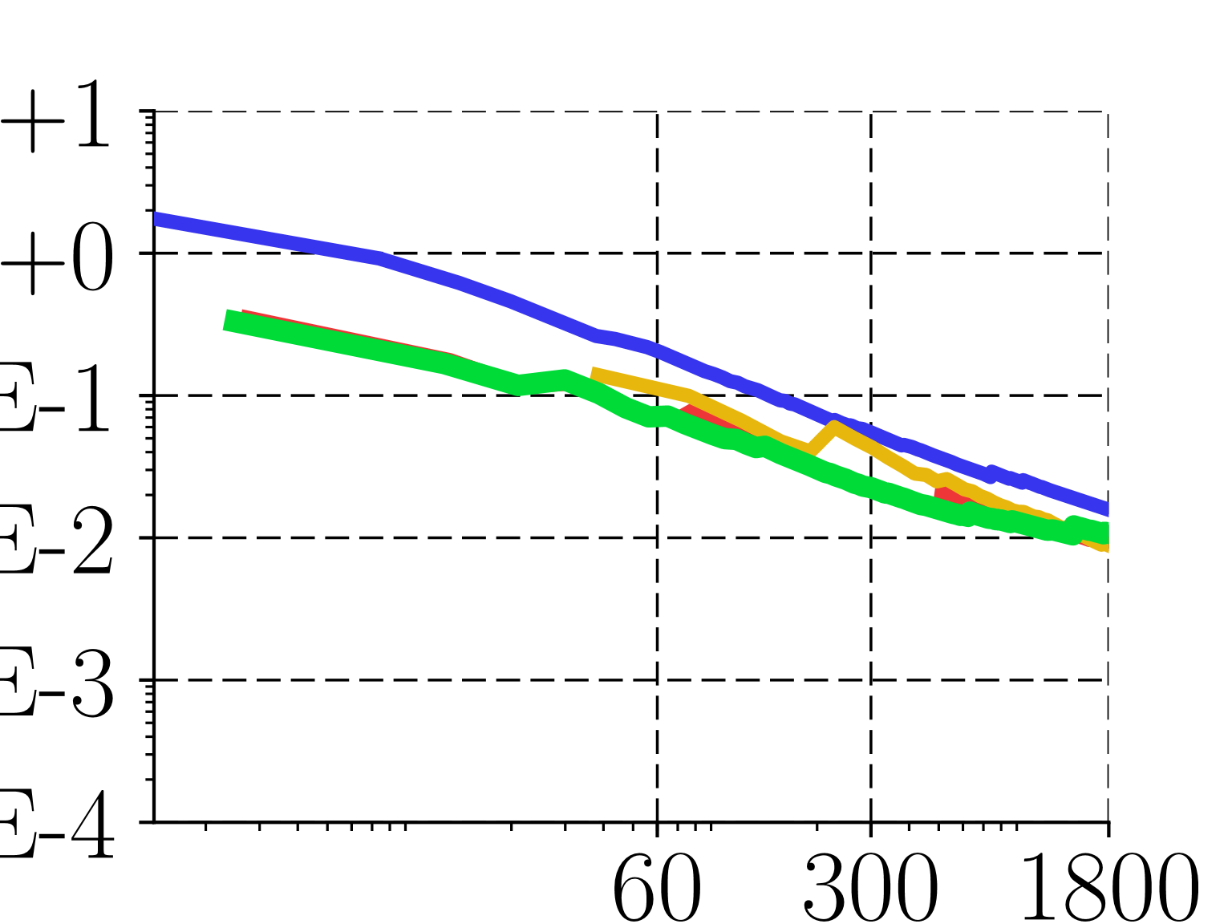

Bookshelf
relMSE
Time
G-BDPT L1
SPPM
Ours L1
Ours L2

Slide 42
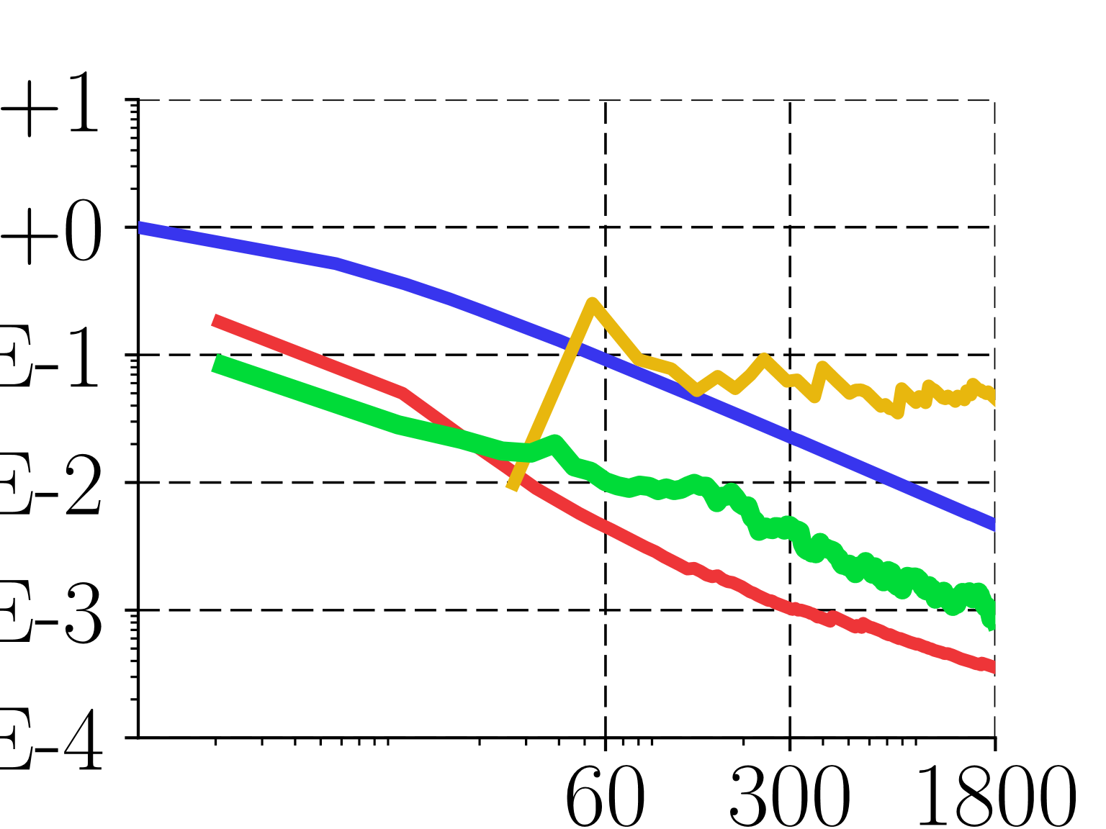

Veach-lamp
relMSE
Time
G-BDPT L1
SPPM
Ours L1
Ours L2

Slide 43
Results – Bookshelf

Slide 44
Results – Bookshelf

Slide 45
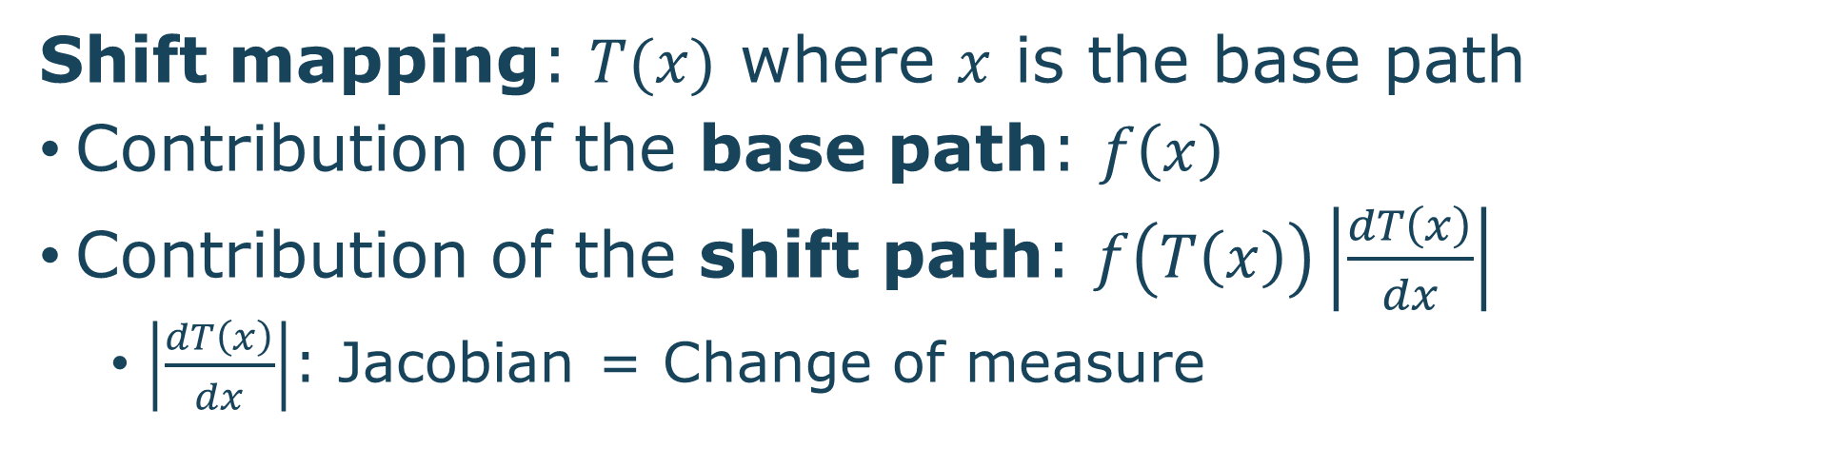
Gradient-domain rendering
Shift mapping: $T(x)$ where $x$ is the base path
Contribution of the base path: $f\left(x\right)$
Contribution of the shift path: $f\left(T\left(x\right)\right)\left|\frac{dT\left(x\right)}{dx}\right|$
  $\left|\frac{dT\left(x\right)}{dx}\right|$: Jacobian = Change of measure
$$Δ\left(x\right)=f\left(T\left(x\right)\right)\left|\frac{dT\left(x\right)}{dx}\right|−f(x)$$
Notes:
In term of mathematic formulation, we define a shift mapping operator T(x) where x is the base path.
Now, when we compute the gradient between the pixel I and j, we have quite the same formulation as classical rendering but we add the shift mapping contribution inside the integral.
You can see that one additional term is visible here, it is the Jacobian. This Jacobian is the change of measure as we have shifted the base path from the pixel i to j. This value is important to compute and we will explain how we compute it in our technique.

Slide 46




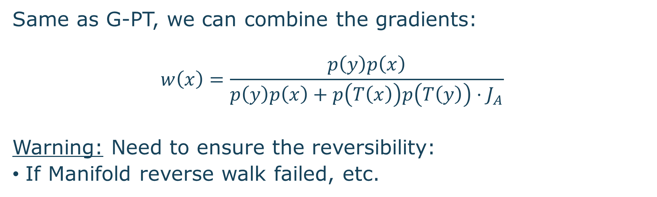
Multiple importance sampling
Forward:
Backward:
Combined:
No MIS (L2 Recons)
Same as G-PT, we can combine the gradients:
$$w\left(x\right)=\frac{p\left(y\right)p\left(x\right)}{p\left(y\right)p\left(x\right)+p\left(T\left(x\right)\right)p\left(T\left(y\right)\right)⋅J_{A}}$$
Warning: Need to ensure the reversibility:
If Manifold reverse walk failed, etc.
MIS (L2 Recons)
Notes:
TODO: Put MIS results

Slide 47
SDS problem in Path-based
Path-based
?
Density-based
S
D

